Slide 1
ADVANCED MACHINE LEARNING MODELS FOR PREDICTIVE ANALYSIS OF PATIENT RISK LEVELS IN CLINICAL DECISION SUPPORT SYSTEMS

Slide 2
Abstract:
The integration of advanced machine learning models into clinical decision support systems (CDSS) offers a transformative approach to predicting patient risk levels with greater accuracy and efficiency. This project leverages supervised learning algorithms, to analyze patient health records and vital parameters for early risk stratification. Implemented using the Django framework, the system facilitates risk level predictions through a secure, web-based interface designed for healthcare professionals. By automating the detection of high-risk patients, the platform enhances clinical decision-making, supports timely interventions, and ultimately contributes to improved patient outcomes. The model is trained and validated on curated medical datasets, ensuring robustness and scalability for deployment in hospital management systems.
Keywords: Machine Learning, Patient Risk Prediction, Clinical Decision Support System, Django Framework, Healthcare Analytics, Risk Stratification, Supervised Learning, Medical Diagnosis.

Slide 3
Existing System:
Physiological reports have confirmed that there are differences in speech signals between depressed and healthy individuals. Therefore, as an application in the field of affective computing, automatic depression level prediction through speech signals has received the attention of researchers, which often estimate the depression severity of individuals by the Fourier or Mel spectrograms of speech signals. However, some studies on speech emotion recognition suggest that directly modeling the raw speech signal is more helpful for extracting emotion-related information. Inspired by this fact, we develop a WavDepressionNet to model raw speech signals for the improvement of prediction accuracy. In our method, a representation block is proposed to find a set of basis vectors to construct the optimal transformation space and generate the transformation result (named Depression Feature Map, DFM) of speech signal for facilitating the perception of depression cues. We further propose an assessment block, which cannot only use the designed spatiotemporal self-calibration mechanism to calibrate the DFM and highlight the useful elements, but also aggregates the calibrated DFM across various temporal ranges with the dilated convolution. Experimental results on the AVEC 2013 and AVEC 2014 depression databases demonstrate the effectiveness of our approach over previous works.

Slide 4
Disadvantages:
there are not utilizing deployment part
there not utilizing machine learning technologies
Focus on Raw Speech
Computational Cost
Data Dependence

Slide 5
Proposed System:
The proposed system aims to revolutionize dairy farming through advanced machine learning techniques tailored for precise milk quality predictions. By integrating data from various sources such as cow health records, environmental conditions, and feed composition, the system will employ supervised learning algorithms to forecast milk quality metrics like fat content, protein levels, and somatic cell counts. Utilizing historical data, the model will continuously improve its accuracy, enabling dairy farmers to preemptively address potential issues that affect milk quality, such as diet adjustments or health interventions for cows. Real-time monitoring and predictive analytics will empower farmers to optimize their operations, enhance herd management practices, and ensure consistent high-quality milk production, thereby promoting sustainability and profitability in the dairy industry.

Slide 6
Advantages:
Early Detection
Improved Decision-Making
Consistent Quality Assurance
Sustainability and Efficiency
High scalability and Adaptability
Empowerment of Farmers
Optimized Resource Allocation

Slide 7
Environmental Requirements:
1. Software Requirements:
Operating System : Windows
Tool : Anaconda with Jupyter Notebook
2. Hardware requirements:
Processor : Intel core i3
Hard disk : minimum 300 GB
RAM : minimum 4 GB

Slide 8
INTRODUCTION
The integration of advanced machine learning models into Clinical Decision Support Systems (CDSS) is revolutionizing the healthcare landscape by enabling more accurate and timely predictions of patient risk levels. This project leverages sophisticated algorithms to analyze diverse patient data and identify potential health risks. By embedding these predictive models within the Django web framework, the system ensures seamless interaction between data processing, model inference, and user interfaces for clinicians. This not only enhances decision-making but also supports early intervention strategies, ultimately improving patient outcomes and optimizing healthcare delivery.

Slide 9
MACHINE LEARNING:
Machine learning is to predict the future from past data. Machine learning (ML) is a type of artificial intelligence (AI) that provides computers with the ability to learn without being explicitly programmed. Machine learning focuses on the development of Computer Programs that can change when exposed to new data and the basics of Machine Learning, implementation of a simple machine learning algorithm using python. Process of training and prediction involves use of specialized algorithms. It feed the training data to an algorithm, and the algorithm uses this training data to give predictions on a new test data. Machine learning can be roughly separated in to three categories. There are supervised learning, unsupervised learning and reinforcement learning. Supervised learning program is both given the input data and the corresponding labeling to learn data has to be labeled by a human being beforehand. Unsupervised learning is no labels. It provided to the learning algorithm. This algorithm has to figure out the clustering of the input data. Finally, Reinforcement learning dynamically interacts with its environment and it receives positive or negative feedback to improve its performance.

Slide 10
Literature survey:
General
A literature review is a body of text that aims to review the critical points of current knowledge on and/or methodological approaches to a particular topic.
It is secondary sources and discuss published information in a particular subject area and sometimes information in a particular subject area within a certain time period.
Its ultimate goal is to bring the reader up to date with current literature on a topic and forms the basis for another goal, such as future research that may be needed in the area and precedes a research proposal and may be just a simple summary of sources. Usually, it has an organizational pattern and combines both summary and synthesis.

Slide 11
Title : MEDIFORECAST: MULTIPLE DISEASE PREDICTION
Author: Vanita Gadekar, Tejas Vishnu Gund,,
Year :2024
Early disease detection is paramount for effective healthcare management. In this research, titled "MediForecast: Multiple Disease Prediction," we address this critical challenge by harnessing the power of machine learning, specifically employing the Support Vector Machine (SVM) classifier algorithm. Focusing on heart disease, Parkinson's disease, and diabetes, we explore innovative approaches to predict these conditions accurately. Our methodology involves meticulous data collection, preprocessing, and feature selection tailored for each disease. We employ the SVM classifier to create robust prediction models. Our implementation demonstrates the practical application of these models, showcasing their effectiveness in diagnosing the aforementioned diseases. The results reveal promising outcomes, indicating high accuracy, sensitivity, and specificity in disease prediction. By empowering medical professionals with timely and precise predictive capabilities, our research contributes significantly to the advancement of healthcare practices. We highlight the transformative potential of machine learning, particularly the SVM classifier, in revolutionizing disease diagnosis, paving the way for a healthier future.

Slide 12
Title : MATERNAL RISK LEVEL PREDICTION USING ENSEMBLE MODEL .
Author: Nirmala, Rekha S Kambli
Year : 2023
In the context of Bangladesh, this work has created a system for accurately monitoring and forecasting a pregnant woman's risk level. Pregnant women's health information and risk factors will be examined by this method to determine the risk intensity level. By 2030, the United Nations wants to lower mother and infant deaths and improve maternal health, but the rate is not declining as quickly as it should. This study evaluated the risk level based on risk factors in pregnancy using the relevant analytical tools and machine learning algorithms. Data on maternal health was acquired for this study from the UCI machine learning library. Risk has been examined using categorization and classification techniques based on risk level. The Random Forest Algorithm provides the highest accuracy of 96% for training data, when it comes to classification and prediction of the risk level, according to a comparison of certain groups of machine learning algorithms.

Slide 13
Title : Automated Pregnancy Risk Level Prediction using Advanced Machine Learning and Deep Learning Algorithm .
Author: Proloy Karmakar.
Year : 2025
Md Sazzad Hossain Department of Computer Mechanical Engineering, Sonargaon University, Dhaka, Bangladesh In this study we analyzed different well-established machine learning (ML) and deep learning (DL) supervised models to enable the risk prediction of maternal health, thus offering a viable and systematic technique to automatically identify pregnancy risk. The Maternal Health Risk Data Set, which covers various critical attributes such as age, blood pressure, blood sugar, body temperature, heart rate, and risk level, was applied [8]. Data pretreatment methods, including deleting missing data (if any) and conducting feature scaling and selection, were incorporated to create the model. Different ML models were created and tested, including but not limited to Support Vector Machine (SVM), Random Forest (RF), and Gradient Boosting (GB), as well as deep learning architectures such as Convolutional Neural Network (CNN), Recurrent Neural Network (RNN), and Long Short-Term Memory (LSTM). Model performances were evaluated using metric measures, including accuracy and F1 scores. Of them, CNN showed the highest accuracy (98.58), exceeding alternative models by its capacity to uncover spatial correlations crucial for successful risk prediction. CNN shows great accuracy, which indicates that its real-life clinical application in predicting high-risk pregnancies would result in a considerable improvement in maternal care. Adding AI-driven models to existing healthcare settings could assist in the faster and more accurate evaluation of pregnancy risk, particularly in low resource settings, boosting focused preventative therapy and evidence-based clinical decision-making. The expanding presence of AI has the potential to revolutionize healthcare, taking us closer to scalable automated solutions for maternal health that correspond with global healthcare development goals, with implications from this study.

Slide 14
Title : MODEL FOR PREDICTING RISK LEVELS IN MATERNAL HEALTHCARE.
Author: Rekha S Kambli1, Nirmala,
Year : 2022
In the context of Bangladesh, a system has been built in this study for efficiently tracking and forecasting a pregnant woman's risk level. To determine the risk intensity level, this system will analyze the health information and risk factors of pregnant women. By 2030, the United Nations wants to improve maternal health and reduce mother and infant mortality; however, the rate is not decreasing as quickly as it should be. This study aimed to determine the risk level based on risk factors in pregnancy using appropriate analytical tools and machine learning algorithms. Data on maternal health were retrieved from the UCI machine learning repository for this study. According to the level of risk, categorization and classification methods have been utilized for the examination of risk variables. The AdaBoost Algorithm provides the highest AUC of 96%, when it comes to classification and prediction of the risk level, according to a comparison of certain groups of machine learning algorithms.

Slide 15
Title : Uncertainty-Aware Pre-Trained Foundation Models for Patient Risk Prediction via Gaussian Process.
Author: Jiaying Lu.
Year : 2022
Patient risk prediction models are crucial as they enable health care providers to proactively identify and address potential health risks. Large pre-trained foundation models offer remarkable per formance in risk prediction tasks by analyzing multimodal patient data. However, a notable limitation of pre-trained foundation mod els lies in their deterministic predictions (i.e., lacking the ability to acknowledge uncertainty). We propose Gaussian Process-based foundation models to enable the generation of accurate predictions with instance-level uncertainty quantification, thus allowing health care professionals to make more informed and cautious decisions. Our proposed approach is principled and architecture-agnostic. Experimental results show that our proposed approach achieves competitive performance on classical classification metrics. More over, we observe that the accuracy of certain predictions is much higher than that of the uncertain ones, which validates the uncer tainty awareness of our proposed method. Therefore, healthcare providers can trust low-uncertainty predictions and conduct more GP Pre-trained Foundation Model NEG POS comprehensive investigations on high-uncertainty predictions, ul timately enhancing patient outcomes with less expert intervention.

Slide 16
Objectives:
To collect and preprocess diverse patient health records and clinical datasets for training predictive models.
To implement and compare advanced machine learning algorithms (e.g.,
To evaluate model performance using metrics such as accuracy, precision, recall, F1-score, and AUC-ROC curve.
To integrate the best-performing model into a Django-based web application for patient risk assessment.
To design a user-friendly interface for healthcare professionals to input patient data and receive risk predictions and clinical recommendations.
To ensure system scalability, data security, and compliance with healthcare data privacy regulations.
To validate the proposed system with clinical experts and assess its effectiveness in supporting decision-making in real-world healthcare environments.

Slide 17
Scope of the Project:
The scope of this project encompasses the development and integration of advanced machine learning models for the predictive analysis of patient risk levels within Clinical Decision Support Systems (CDSS), utilizing the Django framework for seamless web-based deployment. The system aims to process and analyze historical and patient health data, including vital signs, medical history, and lab reports, to classify patients into various risk categories such as low, medium, or high. By leveraging powerful algorithms like the project supports healthcare professionals in making accurate, timely, and data-driven decisions. The Django framework facilitates secure data handling, user-friendly interfaces, and integration with electronic health record systems, ultimately enhancing the quality of patient care and reducing the likelihood of clinical errors.

Slide 18
List of Modules:
Data Pre-processing
Data Analysis of Visualization
SUPPORT VECTOR MACHINE
ADABOOST CLASSIFER
RANDOM FOREST CLASSIFER
Deployment Using DJANGO

Slide 19
PYTHON:
Introduction:
Python is an interpreted high-level general-purpose programming language. Its design philosophy emphasizes code readability with its use of significant indentation. Its language constructs as well as its object-oriented approach aim to help programmers write clear, logical code for small and large-scale projects.

Slide 20
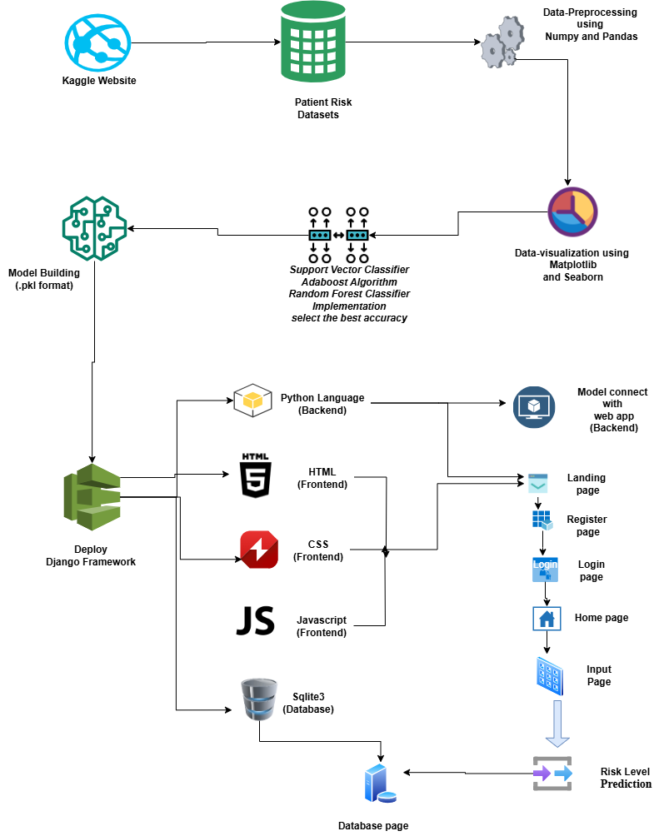
Use Case Diagram:

Slide 21
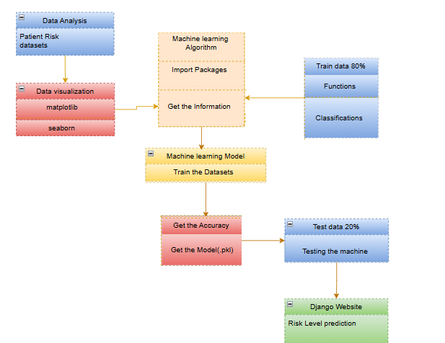
Class Diagram :

Slide 22
Module description:
Data Pre-processing
Validation techniques in machine learning are used to get the error rate of the Machine Learning (ML) model, which can be considered as close to the true error rate of the dataset.
If the data volume is large enough to be representative of the population, you may not need the validation techniques. However, in real-world scenarios, to work with samples of data that may not be a true representative of the population of given dataset. To finding the missing value, duplicate value and description of data type whether it is float variable or integer.
The sample of data used to provide an unbiased evaluation of a model fit on the training dataset while tuning model hyper parameters.

Slide 23
Data Validation/ Cleaning/Preparing Process:
Importing the library packages with loading given dataset. To analyzing the variable identification by data shape, data type and evaluating the missing values, duplicate values.
A validation dataset is a sample of data held back from training your model that is used to give an estimate of model skill while tuning model's and procedures that you can use to make the best use of validation and test datasets when evaluating your models.
Data cleaning / preparing by rename the given dataset and drop the column etc

Slide 24
Exploration data analysis of visualization
Data visualization is an important skill in applied statistics and machine learning.
Statistics does indeed focus on quantitative descriptions and estimations of data.
Data visualization provides an important suite of tools for gaining a qualitative understanding.
This can be helpful when exploring and getting to know a dataset and can help with identifying patterns, corrupt data, outliers, and much more.

Slide 25
Comparing Algorithm with prediction in the form of best accuracy result:
It is important to compare the performance of multiple different machine learning algorithms consistently and it will discover to create a test harness to compare multiple different machine learning algorithms in Python with scikit-learn.
It can use this test harness as a template on your own machine learning problems and add more and different algorithms to compare.
Each model will have different performance characteristics. Using resampling methods like cross validation, you can get an estimate for how accurate each model may be on unseen data.

Slide 26
Algorithm Explanation:
In machine learning and statistics, classification is a supervised learning approach in which the computer program learns from the data input given to it and then uses this learning to classify new observation.
This data set may simply be bi-class (like identifying whether the person is male or female or that the mail is spam or non-spam) or it may be multi-class too.
Some examples of classification problems are: speech recognition, handwriting recognition, bio metric identification, document classification etc

Slide 27
Support Vector Machine or SVM:
Support Vector Machine or SVM is one of the most popular Supervised Learning algorithms, which is used for Classification as well as Regression problems. However, primarily, it is used for Classification problems in Machine Learning.
The goal of the SVM algorithm is to create the best line or decision boundary that can segregate n-dimensional space into classes so that we can easily put the new data point in the correct category in the future. This best decision boundary is called a hyperplane.
SVM chooses the extreme points/vectors that help in creating the hyperplane. These extreme cases are called as support vectors, and hence algorithm is termed as Support Vector Machine. Consider the below diagram in which there are two different categories that are classified using a decision boundary or hyperplane

Slide 28
Adaboost Classifier:
An AdaBoost classifier is a meta-estimator that begins by fitting a classifier on the original dataset and then fits additional copies of the classifier on the same dataset but where the weights of incorrectly classified instances are adjusted such that subsequent classifiers focus more on difficult cases.
AdaBoost can be used to boost the performance of any machine learning algorithm. It is best used with weak learners. These are models that achieve accuracy just above random chance on a classification problem. The most suited and therefore most common algorithm used with AdaBoost are decision trees with one level. How does the AdaBoost algorithm work explain?
It works on the principle of learners growing sequentially. Except for the first, each subsequent learner is grown from previously grown learners. In simple words, weak learners are converted into strong ones. The AdaBoost algorithm works on the same principle as boosting with a slight difference.

Slide 29
Random Forest Classifier:
A Random Forest classifier is a popular ensemble learning algorithm in machine learning that is primarily used for classification tasks. It is based on the idea of creating multiple decision trees during training and then combining their predictions to make more accurate and robust predictions. Random Forests are known for their versatility and ability to handle a wide range of data types and complexities.
Here's a detailed explanation of how the Random Forest classifier works:
Ensemble Learning: The term "ensemble" in machine learning refers to the practice of combining the predictions of multiple models to improve the overall accuracy and reliability. Random Forest is an ensemble method because it combines the predictions of multiple decision trees.
Decision Trees: A decision tree is a simple yet powerful machine learning model that can be used for both classification and regression tasks. It makes decisions by recursively splitting the dataset into subsets based on the values of input features until a stopping condition is met. Each split is determined by selecting the feature that best separates the data according to a certain criterion, typically Gini impurity or information gain for classification tasks.

Slide 30
Django (Web FrameWork) :
Django is a micro web framework written in Python.It is classified as a micro-framework because it does not require particular tools or libraries.It has no database abstraction layer, form validation, or any other components where pre-existing third-party libraries provide common functions.
However, Django supports extensions that can add application features as if they were implemented in Django itself.
Extensions exist for object-relational mappers, form validation, upload handling, various open authentication technologies and several common framework related tools.
Django was created by Armin Ronacher of Pocoo, an international group of Python enthusiasts formed in 2004. According to Ronacher, the idea was originally an April Fool’s joke that was popular enough to make into a serious application. The name is a play on the earlier Bottle framework.

Slide 31
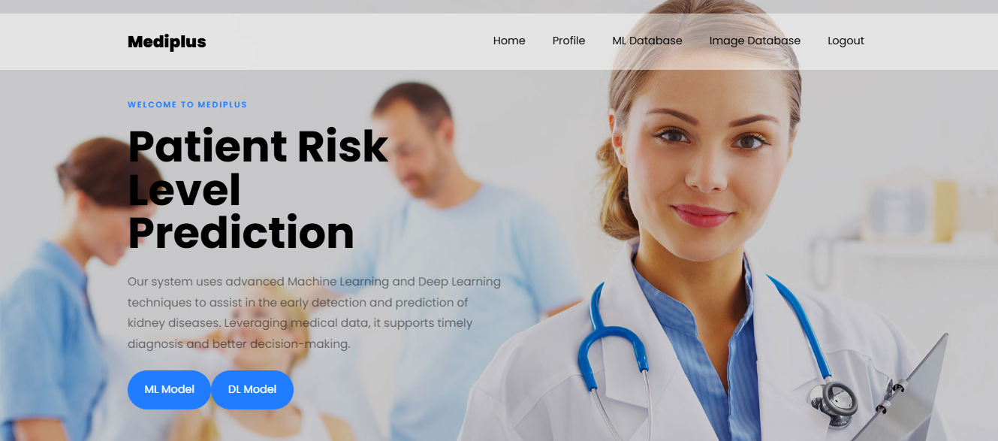
SCREEN SHOT: Home Page:

Slide 32
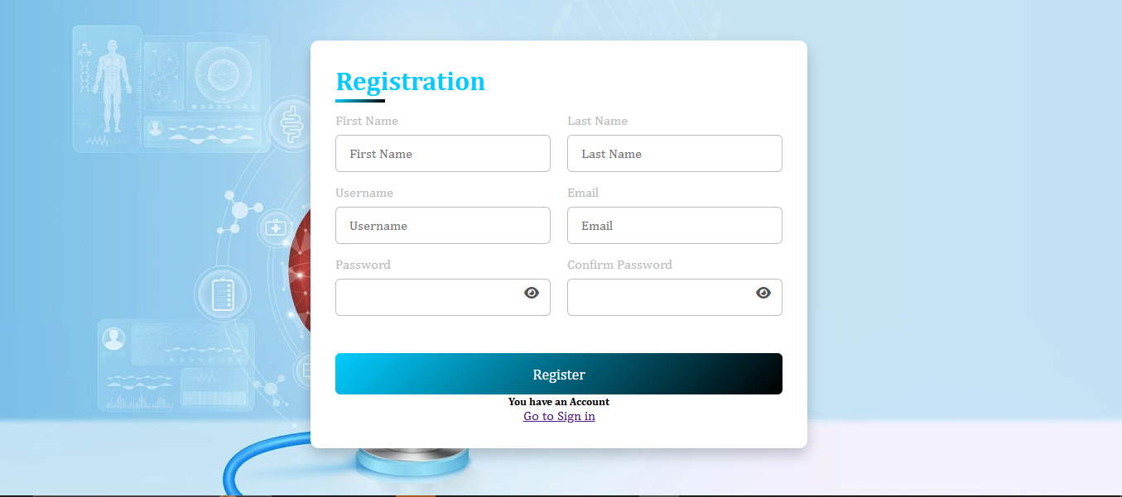
Register Page:

Slide 33
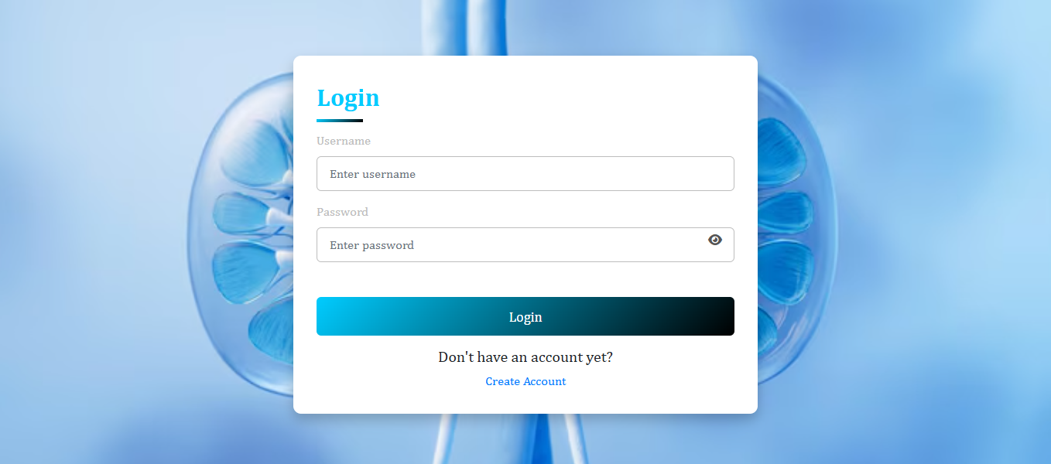
Login Page:

Slide 34
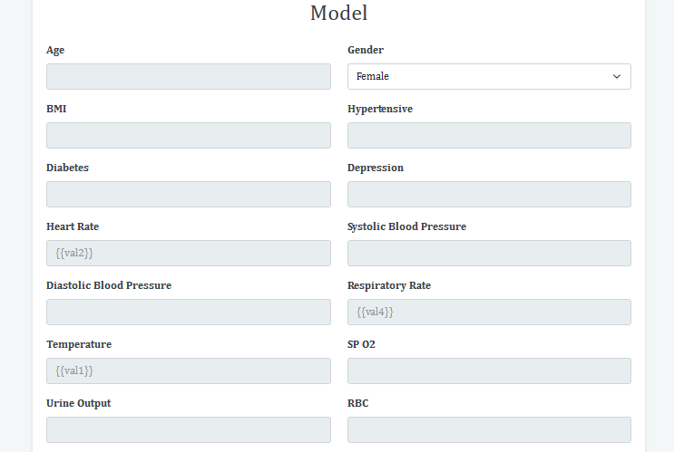
Model Page:

Slide 35
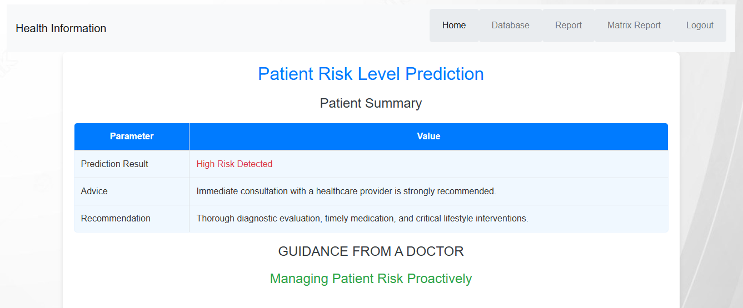
OutPut Page:

Slide 36
Conclusion:
In conclusion, the integration of advanced machine learning models into clinical decision support systems significantly enhances the predictive accuracy and efficiency of patient risk level assessment. By leveraging Django as the development framework, the system ensures robust backend support, scalable deployment, and seamless interaction with medical datasets. The predictive capabilities enable healthcare professionals to make informed decisions in ultimately improving patient outcomes, optimizing resource allocation, and reducing the likelihood of critical health events. This approach represents a transformative step toward intelligent, data-driven healthcare solutions.

Slide 37
Future Work:
Milk adulteration prediction to connect with cloud.
To optimize the work to implement in Artificial Intelligence environment.

